Slide 1




TOC
Mutex
Semaphore
ManualResetEvent
AutoResetEvent

Slide 2
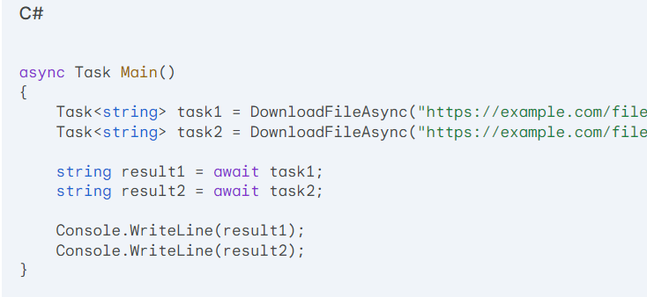

Slide 3
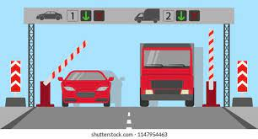


Slide 4
Mutex

Slide 5
Mutex
Purpose: A mutex (mutual exclusion object) is a synchronization primitive used to ensure that only one thread at a time can access a shared resource.
Mechanism: A mutex has a state: either owned or not owned. Only one thread can own a mutex at a time. Other threads that attempt to acquire the mutex must wait until it's released.
Use Cases:
Protecting shared resources like files, database connections, or hardware devices.
Implementing critical sections of code.
Ensuring that only one thread can execute a specific operation at a time.

Slide 6
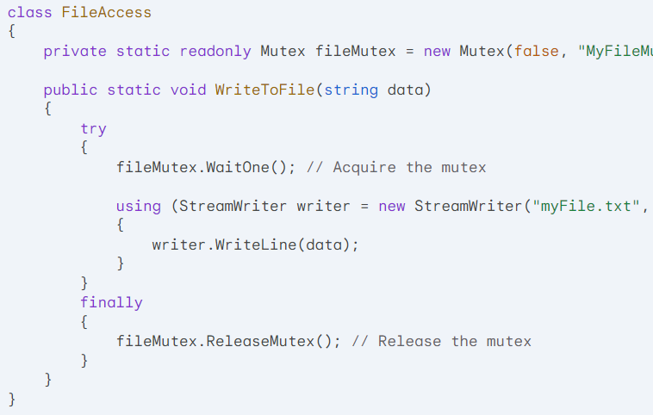
Mutex

Slide 7
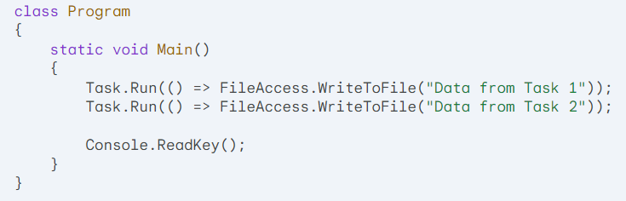
Mutex

Slide 8
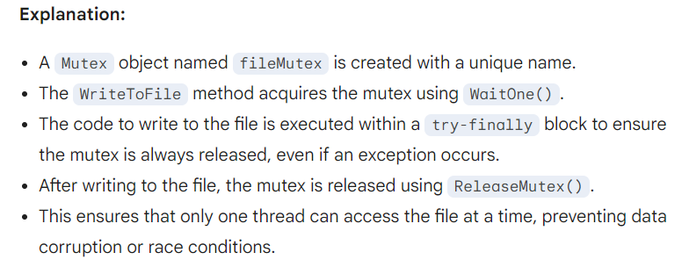
Mutex

Slide 9
Semaphore

Slide 10
Semaphore
Purpose: A semaphore is a synchronization primitive used to control the number of threads that can access a shared resource simultaneously.
Mechanism: A semaphore has a maximum count, which represents the maximum number of threads that can acquire the semaphore at the same time. When a thread acquires the semaphore, its count is decremented. When a thread releases the semaphore, its count is incremented.
Use Cases:
Limiting the number of concurrent connections to a database or web service.
Controlling access to shared resources like printers or devices.
Implementing rate limiting or throttling.

Slide 11
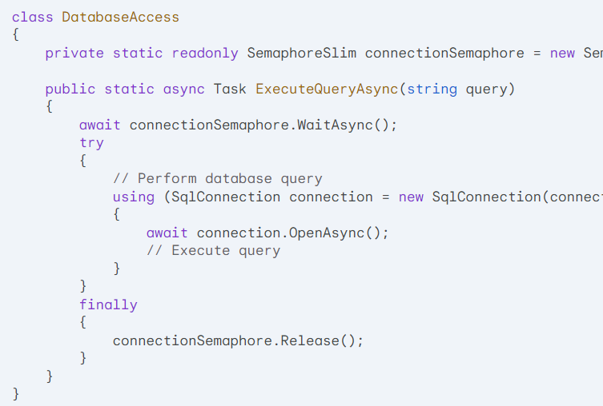
Semaphore

Slide 12
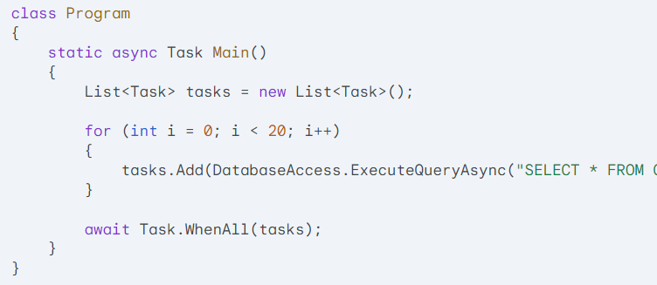
Semaphore

Slide 13
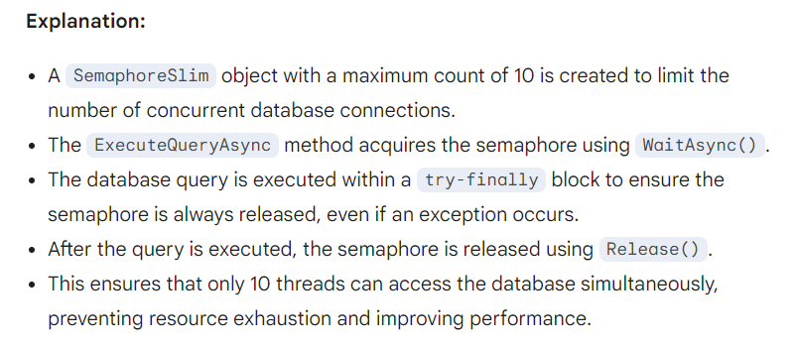
Semaphore

Slide 14
Examples of I/O-bound tasks
File operations:
Reading large files
Writing data to files
Copying or moving files
Network communication:
Making HTTP requests
Downloading or uploading files
Real-time communication (e.g., chat applications)
Database interactions:
Querying large databases
Inserting, updating, or deleting data
Performing database transactions
Web scraping:
Fetching web pages
Parsing HTML content

Slide 15
ManualResetEvent

Slide 16
ManualResetEvent
Purpose: An event wait handle is a synchronization primitive used to signal and wait for events between threads or processes.
Mechanism: An event wait handle has a signaled or non-signaled state. When a thread signals the event, its state becomes signaled. Other threads waiting on the event can then proceed.
Use Cases:
Coordinating the execution of multiple threads or processes.
Implementing producer-consumer patterns.
Signaling the completion of asynchronous operations.

Slide 17
ManualResetEvent
using System;
using System.Threading;
using System.Threading.Tasks;
using System.Collections.Generic;
class ProducerConsumer
{
private readonly Queue<int> dataQueue = new Queue<int>();
private readonly EventWaitHandle dataAvailableEvent = new ManualResetEvent(false);
public void ProduceData()
{
for (int i = 0; i < 10; i++)
{
dataQueue.Enqueue(i);
dataAvailableEvent.Set();
}
}
public void ConsumeData()
{
while (true)
{
dataAvailableEvent.WaitOne();
if (dataQueue.Count > 0)
{
int data = dataQueue.Dequeue();
Console.WriteLine($"Consumed data: {data}");
}
else
{
break;
}
}
}
}

Slide 18
ManualResetEvent
class Program
{
static void Main()
{
ProducerConsumer producerConsumer = new ProducerConsumer();
Task producerTask = Task.Run(() => producerConsumer.ProduceData());
Task consumerTask = Task.Run(() => producerConsumer.ConsumeData());
Task.WaitAll(producerTask, consumerTask);
}
}

Slide 19
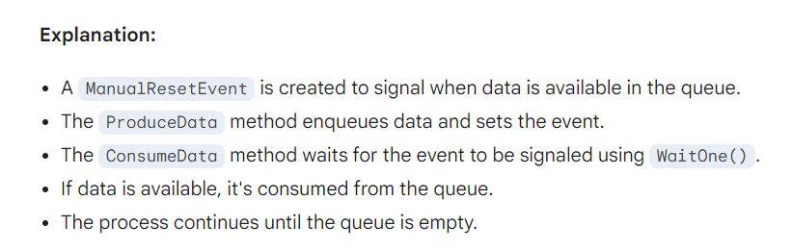
ManualResetEvent

Slide 20
Multiple Producers and Consumers: Coordinate multiple producer and consumer threads.
Barrier Synchronization: Ensure that multiple threads reach a certain point before proceeding.
Global Event Signaling: Signal a global event that multiple threads or processes can wait for.

Slide 21
AutoResetEvent

Slide 22
AutoResetEvent
:
Purpose: An auto reset event is a synchronization primitive used to signal and wait for events between threads or processes.
Mechanism: An auto reset event has a signaled or non-signaled state. When a thread signals the event, its state becomes signaled. The first waiting thread is released, and the event's state automatically resets to non-signaled.
Use Cases:
Implementing producer-consumer patterns.
Coordinating the execution of multiple threads or processes.
Signaling the completion of asynchronous operations.

Slide 23
AutoResetEvent
class ProducerConsumer
{
private readonly Queue<int> dataQueue = new Queue<int>();
private readonly AutoResetEvent dataAvailableEvent = new AutoResetEvent(false);
public void ProduceData()
{
for (int i = 0; i < 10; i++)
{
dataQueue.Enqueue(i);
dataAvailableEvent.Set();
}
}
public void ConsumeData()
{
while (true)
{
dataAvailableEvent.WaitOne();
if (dataQueue.Count > 0)
{
int data = dataQueue.Dequeue();
Console.WriteLine($"Consumed data: {data}");
}
else
{
break;
}
}
}
}

Slide 24
AutoResetEvent
class Program
{
static void Main()
{
ProducerConsumer producerConsumer = new ProducerConsumer();
Task producerTask = Task.Run(() => producerConsumer.ProduceData());
Task consumerTask = Task.Run(() => producerConsumer.ConsumeData());
Task.WaitAll(producerTask, consumerTask);
}
}

Slide 25
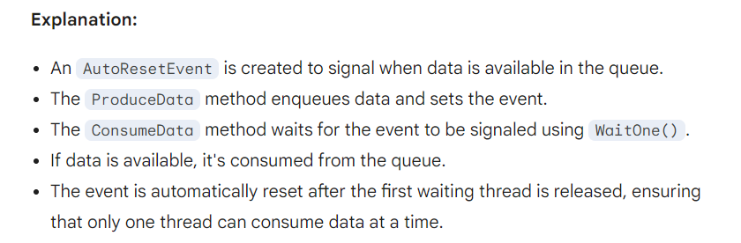
AutoResetEvent

Slide 26
File I/O: Coordinate the reading and writing of a shared file between multiple threads.
Asynchronous Task Completion: Signal the completion of an asynchronous task to other threads.
Data Processing Pipelines: Control the flow of data between stages in a pipeline.
Example: Asynchronous Task Completion

Slide 27
using System;
using System.Threading;
using System.Threading.Tasks;
class AsynchronousTask
{
private readonly AutoResetEvent taskCompletedEvent = new AutoResetEvent(false);
public async Task RunTaskAsync()
{
await Task.Delay(1000); // Simulate a long-running task
taskCompletedEvent.Set();
}
public void WaitForCompletion()
{
taskCompletedEvent.WaitOne();
}
}

Slide 28
class Program
{
static async Task Main()
{
AsynchronousTask task = new AsynchronousTask();
Task taskCompletionTask = task.RunTaskAsync();
// Do other work while the task is running
Console.WriteLine("Performing other tasks...");
await Task.Delay(500);
// Wait for the task to complete
task.WaitForCompletion();
Console.WriteLine("Task completed!");
}
}

